Slide 1
The Role of Copeptin in Type 1 and Type 2 Diabetes: Associations with Metabolic, Vascular, and Kidney Health
Daniel Casillas
MPH Capstone 2025
Department of Biostatistics & Informatics
Colorado School of Public Health, University of Colorado Anschutz Medical Campus
Preceptor: Dr. Petter Bjornstad, University of Washington Medicine Diabetes Institute
Advisors: Dr. Laura Pyle, Ye Ji Choi

Slide 2
Background
Vasopressin (also known as antidiuretic hormone) helps regulate water balance, blood pressure, and several metabolic processes.
Copeptin is a stable peptide released at the same time as vasopressin from the posterior pituitary gland in the brain and is easier to measure than vasopressin and reflects stress level and hydration status within the body.
Higher copeptin levels can indicate higher physiologic stress or lower hydration.
We are interested in how copeptin relates to glycemic control, insulin sensitivity, blood pressure, lipids, and kidney function in youth with diabetes, and whether these relationships differ between type 1 and type 2 diabetes
Notes:
BEST PRACTICES & ACCESSBILITY STANDARDS:
Click on the picture icon to insert new image.
To add a new slide, go to Insert in the navigation bar > New Slide and click the drop-down arrow to choose from different slide layouts and designs.
For body text keep font size at 18pts or larger. For headers keep font size at 24pts or larger.
For any new image or icon you add please add a description in the alt text. Right click image > click on View Alt Text > type in image description

Slide 3
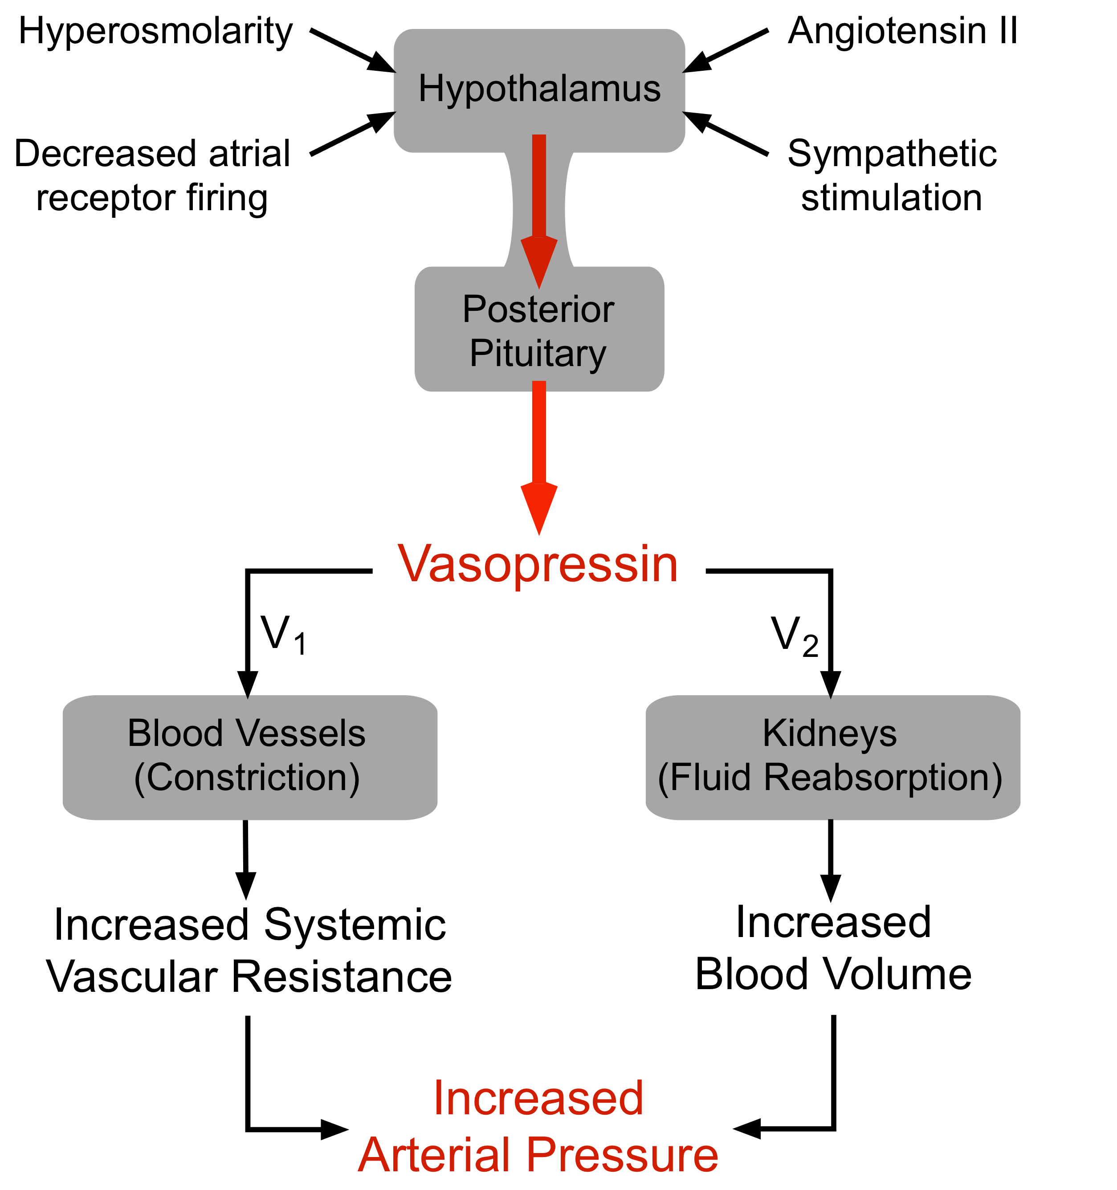

Slide 4
CROCODILE and Renal-HEIRitage Cohorts
CROCODILE: Youth with type 1 diabetes, detailed metabolic and kidney phenotyping, including copeptin
Renal-HEIRitage: Youth with type 2 diabetes, same visit measures to allow direct comparison
Current analysis: Uses both cohorts to compare copeptin relationships by diabetes type

Slide 5
Biomarker Samples Collected: Crocodile and Renal HEIRitage
Complete Blood Counts (CBCs): Assess overall hematologic health and potential inflammation
Hemoglobin A1c (HbA1c): Measure long-term glucose control and metabolic status
Free Fatty Acids (FFA): Reflect lipid metabolism and insulin sensitivity
Copeptin: Serve as a surrogate marker for vasopressin activity and kidney stress
Estimated Glomerular Filtration Rate (eGFR): Evaluate kidney filtration function across both cohorts
Systolic and Diastolic Blood Pressure: Assess cardiovascular status and vascular stress.

Slide 6
Methods
Outcome: Copeptin
Predictors: HbA1c, Systolic and Diastolic Blood Pressure, Insulin Sensitivity , Free Fatty Acids, estimated Glomerular Filtration Rate
Diabetes type (type 1 vs. type 2 diabetes) modeled as a binary variable with a predictor × diabetes type interaction to allow different associations by type.

Slide 7
Descriptive Statistics
Variable | n (All) | Mean (All) | n (T1D) | Mean (T1D) | n (T2D) | Mean (T2D)
Copeptin (pmol/L) | 37 | 7.2 | 8 | 5.7 | 29 | 7.6
Systolic BP (mmHg) | 42 | 123 | 9 | 121 | 33 | 123
Diastolic BP (mmHg) | 42 | 76 | 9 | 79 | 33 | 76
HbA1c (%) | 42 | 7.8 | 9 | 8.1 | 33 | 7.7
eGFR (mL/min/1.73m²) | 42 | 112.3 | 9 | 113.3 | 33 | 112.1
Insulin Sensitivity (GIR) | 33 | 8.15 | 7 | 8.03 | 26 | 8.18
Free Fatty Acids (µmol/L) | 30 | 1125 | 8 | 1357 | 22 | 1041

Slide 8
Unadjusted Interaction Models
General model
Copeptin = β0 + β1·X + β2·1[T2D] + β3·(X × 1[T2D]) + error
HbA1c
Copeptin = 1.346 + 0.536·HbA1c − 4.433·1[T2D] + 1.064·(HbA1c × 1[T2D]) + error
Systolic Blood Pressure
Copeptin = 13.645 − 0.065·SBP − 28.017·1[T2D] + 0.265·(SBP × 1[T2D]) + error
Diastolic Blood Pressure
Copeptin = −3.271 + 0.114·DBP + 21.014·1[T2D] − 0.229·(DBP × 1[T2D]) + error
Insulin Sensitivity
Copeptin = 1.427 + 0.532·GIR 190 + 12.431·1[T2D] − 1.235·(GIR 190 × 1[T2D]) + error
Free Fatty Acids
Copeptin = 5.973 − 0.000231·FFA + 0.834·1[T2D] + 0.001578·(FFA × 1[T2D]) + error
Estimated Glomerular Filtration Rate
Copeptin = −3.062 + 0.0764·eGFR + 10.158·1[T2D] − 0.0576·(eGFR × 1[T2D]) + error

Slide 9
Model Summary
Type 1 diabetes: Copeptin rises with higher HbA1c; other associations are small
Type 2 diabetes: Copeptin tracks metabolic risk (lower insulin sensitivity, higher free fatty acids); HbA1c signal is weaker
Across both types: Little evidence for strong links with eGFR or blood pressure
Overall: Copeptin looks like a marker of glycemic burden in type 1 and broader metabolic stress in type 2

Slide 10
Hematocrit Adjustment
Why Adjust?
  We wanted to ensure differences in hematocrit and plasma volume did not distort copeptin levels or the associations we were studying.
Hematocrit Adjustment
  Hematocrit is the percent of red blood cells
  Copeptin is measured in plasma, so when hematocrit is higher, there is less plasma volume
  To avoid this “volume effect”, I ran secondary models that adjusted for hematocrit effect

Slide 11
  Descriptive statistics (Adjusted for Hematocrit)
Variable | n (All) | Mean (All) | n (T1D) | Mean (T1D) | n (T2D) | Mean (T2D)
Copeptin (pmol/L) | 20 | 7.3 | 8 | 5.5 | 12 | 8.5
Systolic BP (mmHg) | 22 | 120 | 9 | 121 | 13 | 120
Diastolic BP (mmHg) | 22 | 76 | 9 | 79 | 13 | 75
HbA1c (%) | 22 | 8.0 | 9 | 8.1 | 13 | 8.0
eGFR (mL/min/1.73m²) | 22 | 130.1 | 9 | 113.4 | 13 | 141.7
Insulin Sensitivity (GIR) | 16 | 8.1 | 7 | 8.1 | 9 | 8.1
Free Fatty Acids (µmol/L) | 15 | 1167 | 8 | 1426 | 7 | 871

Slide 12
Adjusted Models
General model (with hematocrit)
Copeptin = β0 + β1·X + β2·1[T2D] + β3·(X × 1[T2D]) + β4·Hct + error
HbA1c + hematocrit
Copeptin = 0.134 + 0.523·HbA1c − 4.446·1[T2D] + 1.067·(HbA1c × 1[T2D]) + 0.0306·Hct + error
Systolic Blood Pressure + hematocrit
Copeptin = 12.107 − 0.0669·SBP − 27.374·1[T2D] + 0.2593·(SBP × 1[T2D]) + 0.0408·Hct + error
Diastolic Blood Pressure + hematocrit
Copeptin = −5.391 + 0.1134·DBP + 20.232·1[T2D] − 0.2175·(DBP × 1[T2D]) + 0.0500·Hct + error
Insulin Sensitivity + hematocrit
Copeptin = −4.858 + 0.689·GIR 190 + 12.798·1[T2D] − 1.256·(GIR 190 × 1[T2D]) + 0.1167·Hct + error
Free Fatty Acids+ hematocrit
Copeptin = 0.1014 + 0.000132·FFA + 1.710·1[T2D] + 0.001251·(FFA × 1[T2D]) + 0.1245·Hct + error
Estimated Glomerular Filtration Rate + hematocrit
Copeptin = −8.391 + 0.0853·eGFR + 14.215·1[T2D] − 0.0908·(eGFR × 1[T2D]) + 0.1000·Hct + error

Slide 13
Summary-Adjusted Model
  Adjusting for hematocrit did not change the main patterns
  Type 1 diabetes: copeptin still rises with higher HbA1c; other links are weak
  Type 2 diabetes: copeptin is more related to lower insulin sensitivity and higher free fatty acids than to kidney measures or BP
  Overall, copeptin looks more like a cardiometabolic stress marker than a marker of kidney filtration or resting BP

Slide 14
Overall summary and interpretation
Effect of hematocrit adjustment
  Adding hematocrit as a covariate did not meaningfully change the main patterns by diabetes type.
  This supports that the observed relationships are not driven only by blood concentration effects.
Limitations
  Small cross-sectional sample and multiple predictors, so estimates are imprecise, and results should be viewed as exploratory and hypothesis generating.

Slide 15
Implications and Next Steps
  Copeptin may be useful as a marker of metabolic stress in type 2 diabetes and of chronic hyperglycemia in type 1 diabetes
  Results were unchanged after hematocrit adjustment, but future work should still account for plasma volume
  Larger longitudinal studies that combine metabolic measures, copeptin, and kidney outcomes are needed to confirm these patterns and evaluate prediction of diabetic kidney disease.

Slide 16
Thank you!
Petter Bjornstad, MD, Professor of Pediatrics and Medicine, Director, UW Medicine Diabetes Institute
Laura Pyle, MS, PhD, Research Professor, Division of Metabolism, Endocrinology and Nutrition; Director of Biostatistics, UW Medicine Diabetes Institute, University of Washington
Ye Ji Choi, MPH, Research Scientist/Engineer, Kidney Research Institute and Department of Medicine, University of Washington
Eleanor Cotton, MS, Research Instructor, Department of Biostatistics & Informatics, Colorado School of Public Health, University of Colorado Anschutz Medical Campus
Gregory Tung, PhD, MPH, Department of Health Systems, Management & Policy

