Slide 1


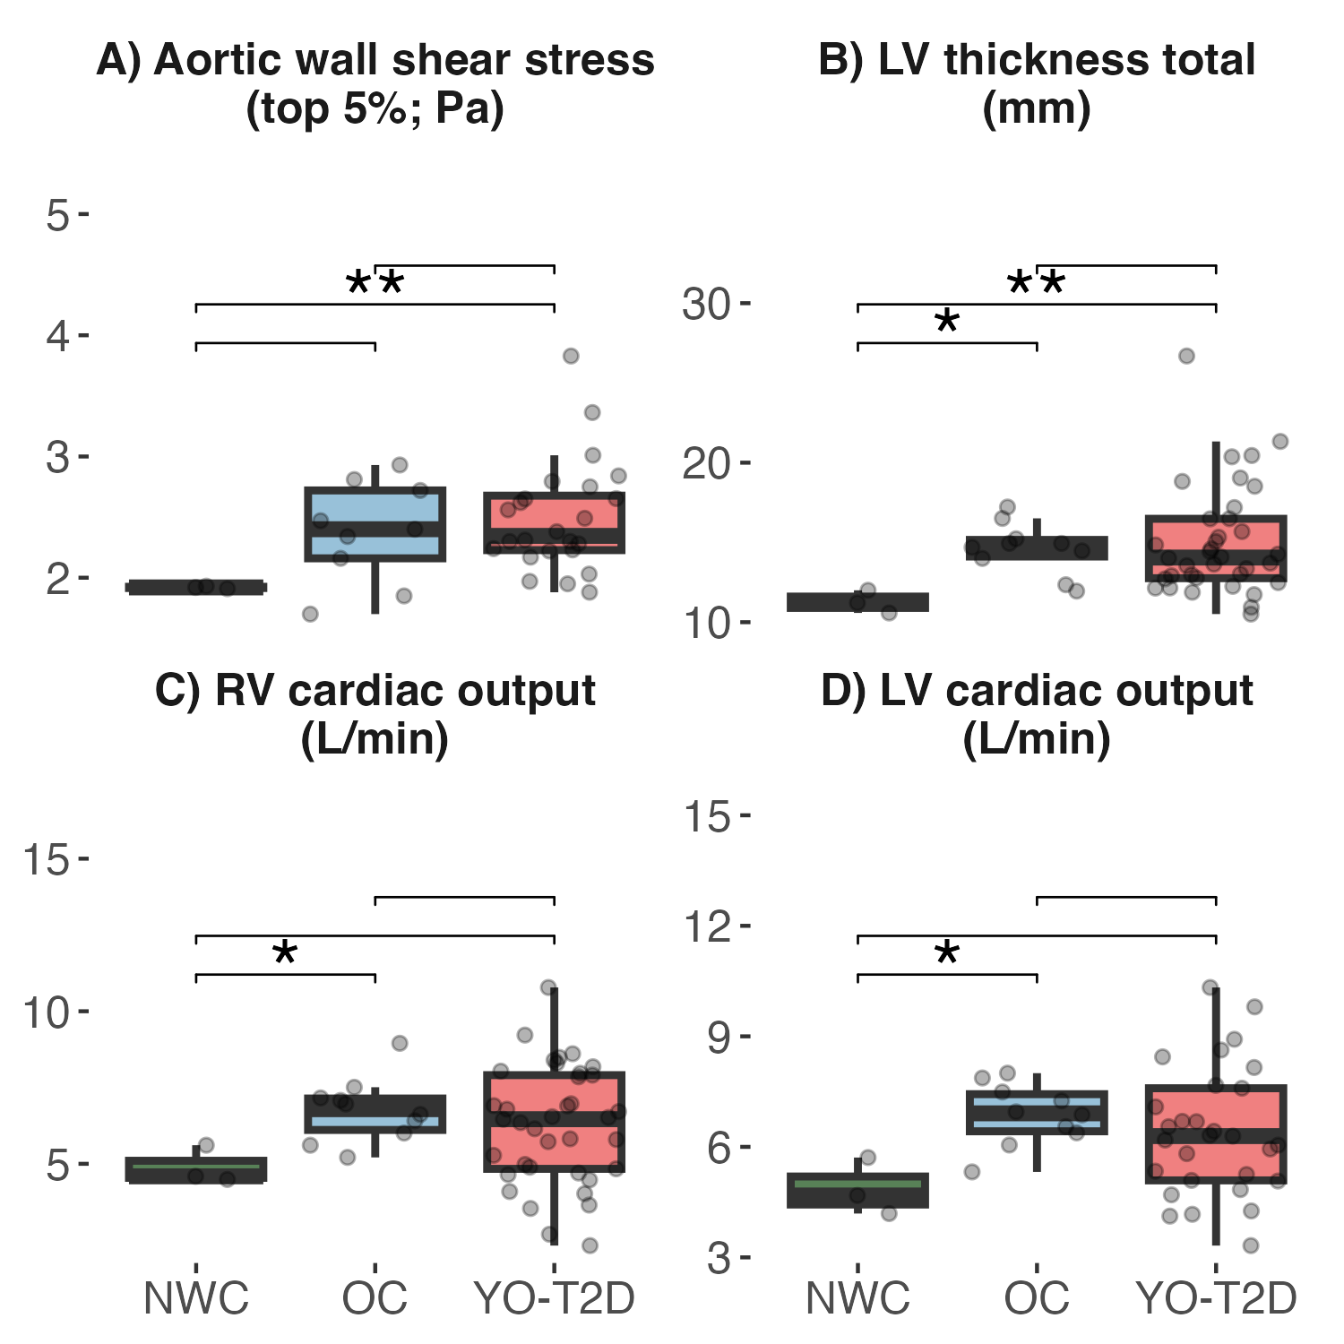
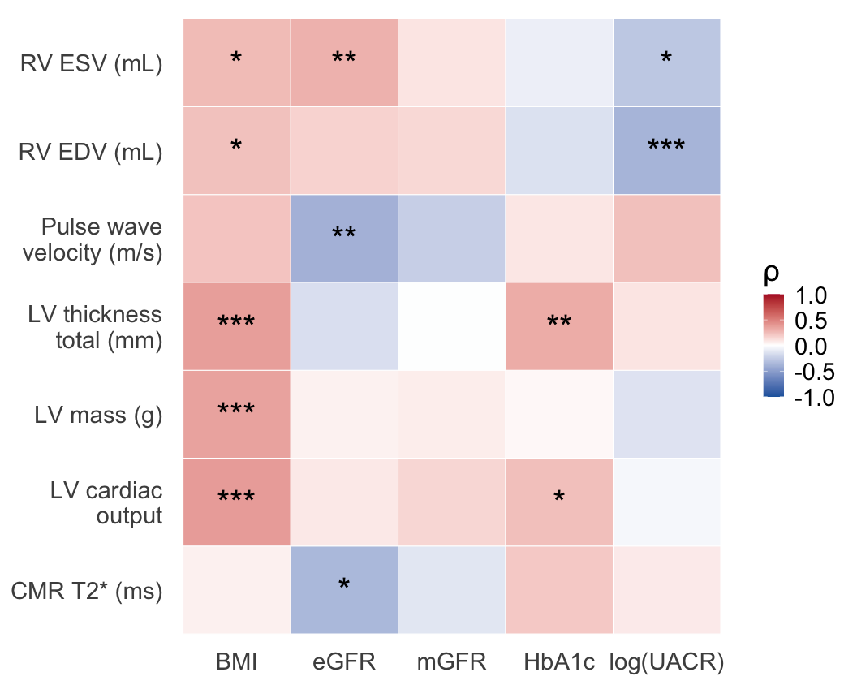
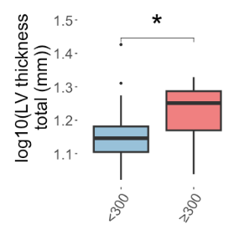
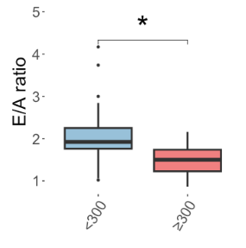
Obesity Drives Cardiac Hypertrophy while Diabetic Kidney Disease Links to
Diastolic Dysfunction and Vascular Stiffness in Young Adults with Type 2 Diabetes
Kalie L. Tommerdahl^{1,4}, Ye Ji Choi^{1,*}, Sungho Park^{2,*}, Shivani Ramesh¹, Jennifer Romanowicz³, Laura Pyle^{1,4}, Jairo Pinzon-Cortes¹, Daniël van Raalte⁵, Nisha Bansal⁶, Ian H. de Boer⁶, Megan Kelsey⁷, Lori Laffel⁸, Michal Schäfer³, Benjamin Frank³, Karin Bornfeldt¹, Jenny Kanter¹, Michael Granda⁷, Benthe Ariens⁵, Erin Englund², David Cherney⁹, Alexander Kula¹⁰, Janet Snell-Bergeon¹¹, Daniel Casillas⁷, Alyssa Caldwell-McGee⁷, Frederik Persson¹², Carissa Birznieks⁷, Amy Rydin⁷, Tyler Dobbs⁷, Lorna Browne², Kristen Nadeau⁷, Alex J. Barker^{2,**}, Petter Bjornstad^{1,4,**}
¹ Division of Metabolism, Endocrinology, and Diabetes, Department of Medicine, University of Washington School of Medicine, Seattle, WA, USA, ² Department of Radiology, University of Colorado School of Medicine, Aurora, CO, USA, ³ Department of Pediatrics, Section of Cardiology, University of Colorado School of Medicine, Aurora, CO, USA, ⁴ Center for Clinical and Translational Research, Seattle Children’s, Seattle, WA, USA, ⁵ Diabetes Center, Department of Internal Medicine, Amsterdam University Medical Centers, Amsterdam, The Netherlands, ⁶ Division of Nephrology, Department of Medicine, Kidney Research Institute, University of Washington School of Medicine, Seattle, WA, USA, ⁷ Department of Pediatrics, Section of Endocrinology, University of Colorado School of Medicine, Aurora, CO, USA, ⁸ Pediatric, Adolescent and Young Adult Section, Joslin Diabetes Center, Department of Pediatrics, Harvard Medical School, Boston, MA, USA, ⁹ Division of Nephrology, Department of Medicine, University of Toronto, Toronto, ON, Canada, ¹⁰ Division of Nephrology, Department of Pediatrics, Ann & Robert H. Lurie Children’s Hospital of Chicago, Northwestern University Feinberg School of Medicine, Chicago, IL, USA, ¹¹ Barbara Davis Center for Diabetes, University of Colorado School of Medicine, Aurora, CO, USA, ¹² Steno Diabetes Center Copenhagen, Herlev, Denmark, * Co-first authors, ** Co-senior authors
BACKGROUND
Fig 1. CMR comparisons between groups
Fig 2. Spearman correlations between CMR and clinical measures
Fig 3. CMR comparisons between
albuminuria groups
Young-onset type 2 diabetes (YO-T2D) has an aggressive phenotype associated with obesity, kidney disease, and premature heart failure.
However, the specific contributions of adiposity and kidney dysfunction to developing early cardiac remodeling remain unclear.
We used multiparametric cardiac MRI (CMR) to investigate drivers of change in cardiac structure, function, and tissue remodeling.
METHODS
Young adults with YO-T2D, obesity (OC), and normal weight controls (NWC) in the SWEETHEART, ULTRA, and IMPROVE-T2D studies were recruited for CMR w/ a Phillips 3T scanner.
Kidney function was assessed by:
  Urinary albumin-to-creatinine ratio (UACR) from an early AM void
  Estimated glomerular filtration rate (eGFR, CKD-EPI creatinine and cystatin C)
  Measured GFR (iohexol clearance)
Pairwise Wilcoxon rank sum tests and Spearman correlations compared CMR measures and assessed associations with kidney function.
In those w/ T2D and OC, those w/ severe albuminuria (UACR ≥ 300mg/g; N=7) had significantly lower E/A ratio (diastolic dysfunction) and higher LV thickness than those w/ UACR <300 mg/g (N=47; Fig. 3).
Participants w/ YO-T2D had elevated thoracic aortic wall shear stress (WSS) and left ventricular (LV) thickness vs. OC and NWC (Fig. 1A & B).
OC had significantly higher right ventricular (RV) and LV cardiac output vs. NWC. YO-T2D had numerically higher pattern (Fig. 1C & D).
Higher A1c and BMI associated with LV myocardial thickness (Fig. 2).
Lower eGFR associated w/ higher aortic pulse wave velocity (PWV; Fig. 2).
Higher UACR associated w/ lower RV end systolic volume (ESV) and end diastolic volume (EDV; Fig. 2).
RESULTS
Among 58 participants (44 YO-T2D, 10 OC, 4 NWC; 48% female; mean age 21±6, 25±9, and 18±1 years, respectively), YO-T2D had higher A1c (7.2±2.2 vs. 5.3±0.4 vs. 5.1±0.2%) and BMI (40.7±10.1 vs. 36.5±7.0 vs. 22.8±2.8 kg/m²), with preserved eGFR (121±35, 120±23, 130±10 mL/min/1.73m²) across groups.
CONCLUSION
Early cardiovascular remodeling in YO-T2D indicates adverse cardiac changes are detectable well before clinical heart failure.
BMI and A1c were the strongest correlates of LV thickness and mass, implicating obesity- and hyperglycemia-mediated concentric remodeling.
Lower eGFR tracked with higher aortic PWV (stiffening); higher UACR tracked with reduced RV volume.
UACR ≥ 300 mg/g correlated w/ greater LV thickness and lower E/A ratio, signaling a transition toward clinically meaningful diastolic dysfunction.

